Slide 1

Census Data Analysis
Sai charan doniparthi

Slide 2
Introduction
The Census Income dataset consists of approximately 5,000 records and provides comprehensive information about individual’s demographic characteristics, education, occupation, and income. The dataset's size and scope make it an ideal resource for analyzing the relationship between these variables and identifying the key factors that determine income levels. The presentation focuses on three main questions related to income, demographic characteristics, education, and occupation.

Slide 3
Research questions
What characteristics of high income (>$50,000) are most strongly associated, and how do these characteristics vary between men and women?
Is there a relationship between income and education that holds true for all racial and ethnic groups?
Are there certain sectors that regularly pay greater wages than others, and how do profession and industry type affect income?

Slide 4
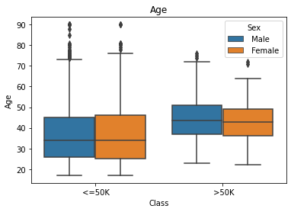
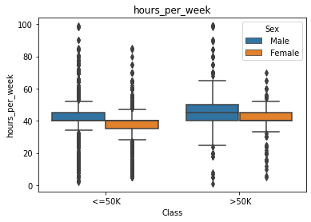
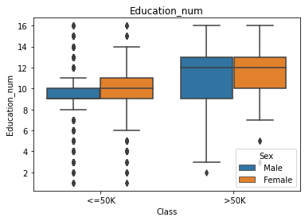
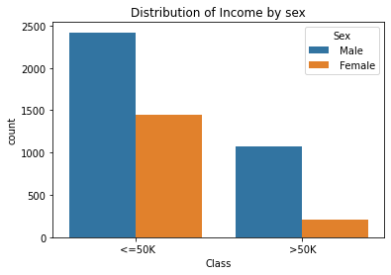
Plots and findings

Slide 5
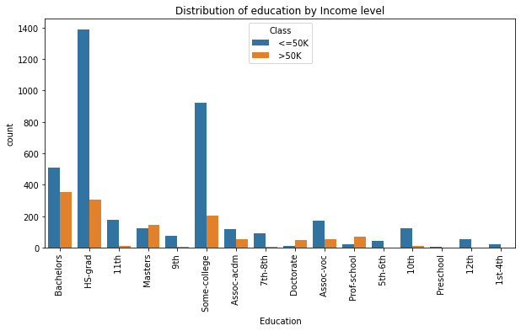
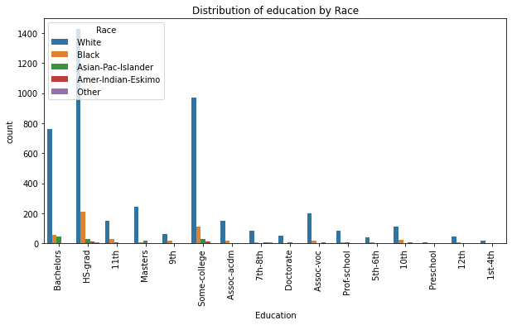
Plots and findings

Slide 6
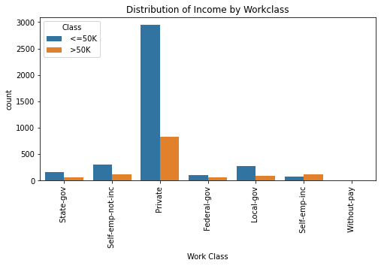
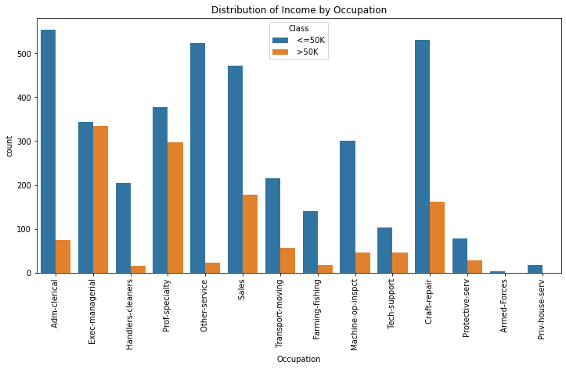
Plots and findings

